Slide 1


SENTIMENT ANALYSIS OF RESTAURENT REVIEWS
PRESENTED BY:
THONTLA KASIREDDY
RAJIV GANDHI UNIVERSITY OF KNOWLEDGE TECHNOLOGIES-SRIKAKULAM
COMPUTER SCIENCE AND ENGINEERING

Slide 2
OUTLINE:
Problem Statement
Proposed System
System Development Approach (Technology Used)
Result (Output Image)
Conclusion
Future Scope
References

Slide 3

PROBLEM STATEMENT:
Understanding customer sentiment from online reviews is crucial for restaurants to improve service and reputation. Developing a machine learning model to classify reviews as positive or negative helps restaurants gauge customer satisfaction effectively. The goal is to accurately predict sentiment to enhance customer experience and loyalty.

Slide 4
PROPOSED SOLUTION:
The proposed system aims to address the challenge of sentiment analysis for restaurant reviews using machine learning techniques. This involves leveraging Natural Language Processing (NLP) to predict whether a review is positive or negative based on its text content.
The solution will consist of the following components:
Data Collection:
Gather restaurant reviews data including text and sentiment labels (positive or negative).
Data Preprocessing:
Clean and preprocess text data to remove punctuation, convert to lowercase, and handle stopwords.
Tokenize the text into individual words and perform stemming or lemmatization to normalize the words.

Slide 5
Feature Extraction:
Convert text data into numerical feature vectors using techniques like TF-IDF.
Machine Learning Model:
Implement various classification algorithms such as Naive Bayes, Support Vector Machines (SVM).
Train the model on labeled data (reviews with sentiment labels).
Evaluation:
Evaluate the model's performance using metrics like accuracy, precision, recall, and F1-score.
Use techniques like cross-validation to ensure the model's robustness and generalization.
Result:
Provide actionable insights to restaurant owners based on sentiment analysis of customer reviews, enabling them to understand customer satisfaction levels and improve service accordingly.

Slide 6
SYSTEM APPROACH:
System Requirements
Python Libraries:
pandas, numpy: For data handling and numerical operations.
matplotlib: For visualizing data.
nltk: For text preprocessing tasks like cleaning and tokenization.
sklearn: For machine learning models and evaluation metrics.
wordcloud: For generating word clouds.
textblob: For sentiment analysis using a pre-trained model.
Dataset:
A dataset containing customer reviews labeled with sentiments (positive or negative).

Slide 7
Methodology:
Data Preprocessing:
1.Text Cleaning:
Remove punctuation, convert to lowercase, and remove stopwords using nltk.
2.Tokenization:
Split text into words or tokens using nltk.
3.Vectorization:
Convert text data into numerical features using sklearn's TfidfVectorizer or CountVectorizer.
Exploratory Data Analysis (EDA):
Word Cloud:
Visualize most frequent words in positive and negative reviews using wordcloud.
Distribution Analysis:
Understand the distribution of review lengths and sentiments with basic plots using matplotlib.

Slide 8
Model Building:
1.Train-Test Split:
Split dataset into training and testing sets using sklearn.
2.Feature Extraction:
Use TfidfVectorizer or CountVectorizer to transform text into numerical features.
3.Model Selection:
Choose a machine learning model such as Naive Bayes (MultinomialNB) or SVM (LinearSVC) .
4.Model Training:
Train the selected model on the training data.
5.Model Evaluation:
Evaluate model performance using accuracy, confusion matrix, and classification report metrics .
Sentiment Prediction:
Develop a function to predict sentiment for new reviews using the trained model.
Apply the function to predict sentiments for new reviews or integrate into an application interface.

Slide 9
ALGORITHMS:
Algorithm Selection:
For sentiment analysis, we chose two primary algorithms: Naive Bayes and Support Vector Machines (SVM).
Naive Bayes: Naive Bayes is a probabilistic classifier based on Bayes' theorem with strong independence assumptions between features. It is well-suited for text classification tasks like sentiment analysis due to its simplicity and efficiency in handling large feature spaces (in this case, word frequencies or TF-IDF values).
Support Vector Machines (SVM): SVM is a powerful supervised learning algorithm used for classification tasks. It works by finding an optimal hyperplane that best separates data points belonging to different classes. SVM with a linear kernel is particularly effective when the data is linearly separable or can be transformed into a linearly separable form, making it suitable for text classification tasks like sentiment analysis.

Slide 10
Data Input:
The algorithms utilize the preprocessed text data from the 'Cleaned_Review' column. Each review has undergone text cleaning to remove stopwords, punctuation, and non-alphabetic characters.
Training Process:
Naive Bayes:
Vectorization: The text data is transformed into TF-IDF vectors, capturing the importance of words in distinguishing sentiment.
Model Training: Trained using Multinomial Naive Bayes classifier on the TF-IDF vectors of the training set (X_train_tfidf).
Support Vector Machines (SVM):
Vectorization: Similar TF-IDF vectorization is applied to convert text into numerical features.
Model Training: SVM with a linear kernel is trained on the TF-IDF vectors of the training data (X_train_tfidf).
Prediction Process:
After training, both models predict sentiment for new reviews

Slide 11
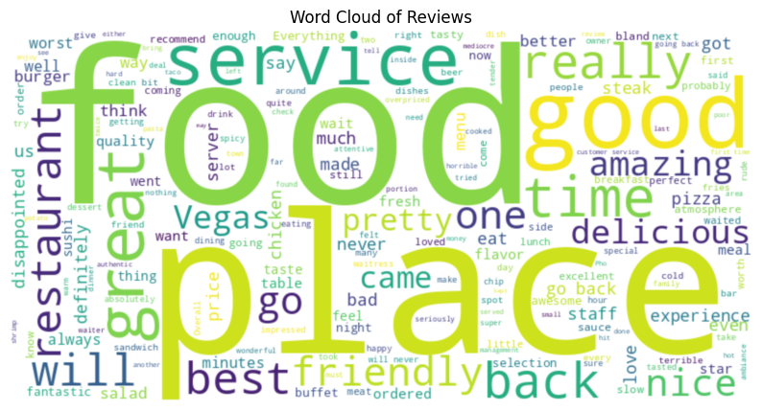
RESULT:
WORD CLOUD:

Slide 12
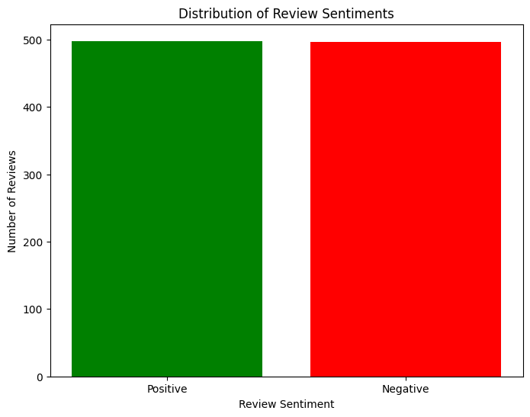
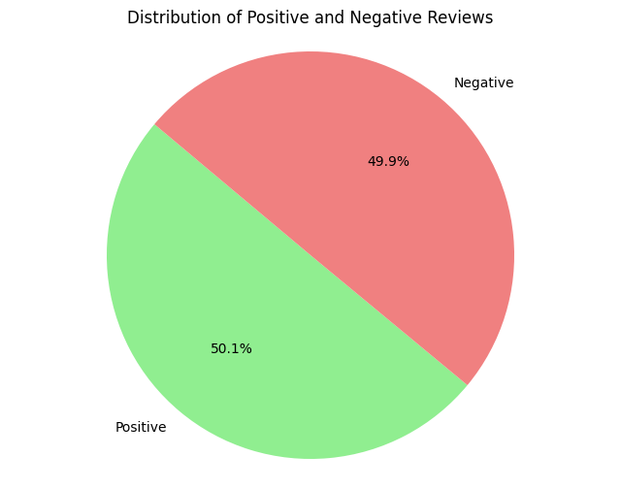
BAR PLOT:
PIE CHART:

Slide 13
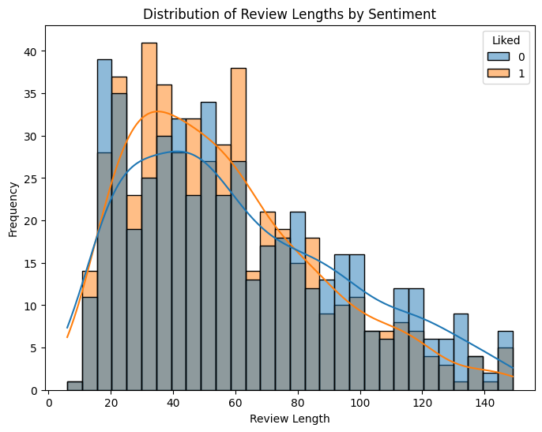
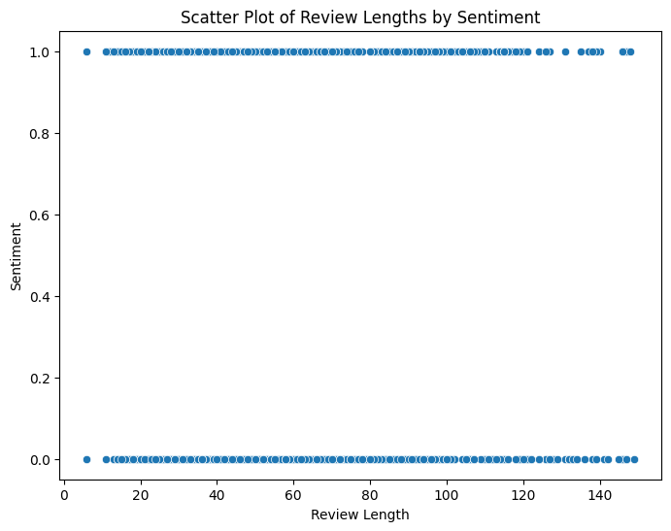
HISTOGRAM:
SCATTER PLOT:

Slide 14
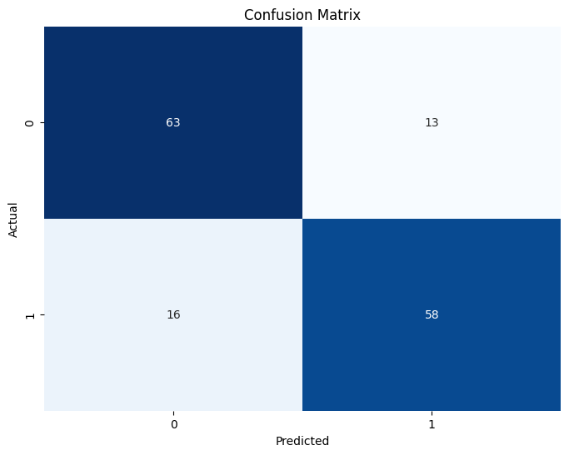
CONFUSION MATRIX:

Slide 15
CONCLUSION:
Implemented sentiment analysis on restaurant reviews using both Naive Bayes and SVM classifiers. Achieved an accuracy of 80.67% with SVM, which outperformed Naive Bayes (78%). Cleaned text data by removing stopwords and applied TF-IDF vectorization for feature extraction. Visualized model performance with confusion matrices and deployed a pipeline for predicting sentiment on new reviews, enhancing scalability and usability.
FUTURE SCOPE:
1.Fine-tuning Models: Refine machine learning models with more restaurant-specific data to enhance accuracy and relevance of sentiment predictions.
2.User Interaction Integration: Incorporate user interaction data (like ratings, clicks, or reviews) to personalize sentiment analysis for individual preferences and behaviors.
3.Real-time Feedback: Develop systems that provide real-time feedback to restaurants based on sentiment analysis, enabling quicker responses to customer experiences and issues.

Slide 16
REFERENCES:
1.B. Pang, L. Lee, and S. Vaithyanathan, "Thumbs up? Sentiment Classification using Machine Learning Techniques," Proceedings of the ACL-02 Conference on Empirical Methods in Natural Language Processing, pp. 79-86, 2002.
2.M. S. S. M. S. S. Qadir and A. A. Malik, "Sentiment Analysis of Restaurant Reviews Using Deep Learning," IEEE Access, vol. 7, pp. 51000-51009, 2019.
3.Y. Zhang, S. Zhang, and L. Yao, "Reviewing the reviews: A comparative study of sentiment analysis techniques in opinion mining," IEEE Transactions on Knowledge and Data Engineering, vol. 32, no. 3, pp. 520-532, March 2020.
GIT LINK:
https://github.com/tkreddy626/kasireddy_sentiment_analysis.git

